Slide 1


Gopika H
21 Jan 2024

Slide 2

Outline
Executive Summary
Introduction
Methodology
Results
Conclusion
Appendix

Slide 3
Executive Summary
Summary of methodologies
Data collection
Data wrangling
EDA with Data visualization
EDA with SQL
Building an interative map with Folium
Building a Dashboard with plotly dash
Predictive analysis
Summary of all results
EDA results
Interactive analytics
Predictive analysis

Slide 4
Introduction
Project background and context
SpaceX advertises Falcon 9 rocket launches on its website, with a cost of 62 million dollars, other providers cost upward of 165 million dollars each, much of savings is because SpaceX can reuse the first stage
Problems you want to find answers
The project task is to predicting if the first stage of the SpaceX Falcon 9 rocket will land successfully.

Slide 5

Section 1

Slide 6
Methodology
Executive Summary
Data collection methodology:
SpaceX Rest API
Web Scrapping
Perform data wrangling
One Hot Encoding Data fields for Machine learning and data cleaning of null values and irrelevant columns
Perform exploratory data analysis (EDA) using visualization and SQL
Perform interactive visual analytics using Folium and Plotly Dash
Perform predictive analysis using classification models
LR, KNN, SVM, DT models have been built for the best classifier

Slide 7
Data Collection
SpaceX launch data that is gathered from the SpaceX REST API.
This API will give us data about launches, including information about the rocket used, payload delivered, launch specifications, landing specifications, and landing outcome.
The SpaceX REST API endpoints or URL, starts with api.spacexdata.com/v4/
Another popular data source for obtaining Falcon 9 Launch data is web scrapping Wikipedia using BeautifulSoup.

Slide 8
Data Collection – SpaceX API
SpaceX REST API endpoint
Get request using the requests library
Extract information about booster name, launch site, payload mass and landing site
Get the past launch data as a JSON object
Data Wrangling
Deal with Missing Values
Filter the dataframe to only include Falcon 9 launches
Convert the JSON to a dataframe

Slide 9
Data Collection - Scraping
Request the Falcon9 Launch Wikipedia from its URL
BeautifulSoup object from the response
Extract all column/variable names from the HTML table header
Create a data frame by parsing the launch HTML tables
Data Wrangling

Slide 10
Data Wrangling
Check null values
Calculate the number of launches on each site
Calculate the number and occurrence of each orbit
Calculate the number and occurrence of mission outcome per orbit type
Create a landing outcome label from Outcome column
Handle null values

Slide 11
EDA with Data Visualization
Catplot to visualize the relationship between flight number and Payload.
Catplot to visualize the relationship between flight number and launch site.
Catplot to visualize the relationship between Payload and launch site.
Bar chart to visualize the relationship between success rate of each Orbit type.
Catplot to visualize the relationship between flight number and orbit type.
Catplot to visualize the relationship between Payload and orbit type.
Line chart to visualize the launch success early trend.

Slide 12
EDA with SQL
Displaying the name of unique launch site in the space mission
Displaying 5 records where launch sites begin with string KSC
Displaying the total payload mass carried by boosters launched by NASA
Displaying average payload mass carried by booster version F9 v1.1
Listing the data where the successful landing outcome in drone ship was achieved
Listing the names of the boosters which have success in ground pad and have payload mass greater than 4000 but less than 6000
Listing the total number of successful and failure mission outcomes
Listing the names of the booster versions which have carried the maximum payload mass
Listing the records which will display the month names, successful landing outcomes in ground pad, booster versions, launch site for the month in year 2017
Ranking the count of successful landing outcomes between the date 2010 06 04 and 2017 03 20 in descending order.

Slide 13
Build an Interactive Map with Folium
folium.Circle and folium.Marker to add a highlighted circle area with a test label on a specific coordinate for each launch site on the site map
MarkerCluster object for simplify a map containing many markers having the same coordinate.
Mouse position on the map to get coordinate for a mouse over a point on the map.
Folium.Polyline object to draw a line between a launch site to its closest city, railway and highway

Slide 14
Build a Dashboard with Plotly Dash
A launch site Drop-down Input Component. There are four different launch sites and a dropdown menu let us select different launch sites.
A callback function to render success-pie-chart based on selected site dropdown. The general idea of this callback function is to get the selected launch site fron site-dropdown and render a pie chart visualizing launch success counts.
A range Slider to Select Payload. The Slider is to be able to easily select different payload range and see if we can identify some visual patterns.

Slide 15
Predictive Analysis (Classification)
Creation of a NumPy array from the column class in data.
Data standardization
Use of the function train_test_split to split the data X and Y into training and text data.
Searching for the best hyperparameters for Logistic regression, SVM, Decision tree and KNN classifiers.
Searching for the method that performs best using text data.

Slide 16
Results
Exploratory data analysis results
Interactive analytics demo in screenshots
Predictive analysis results

Slide 17

Section 2

Slide 18
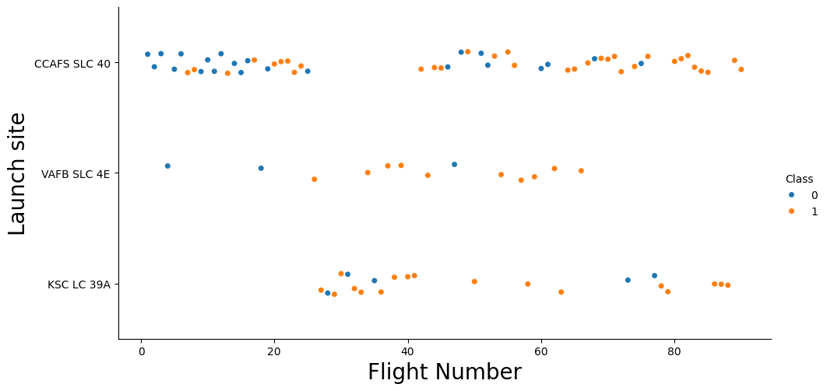
Flight Number vs. Launch Site
Launches from the site of CCAFS SLC 40 are significantly higher than launches from other sites

Slide 19
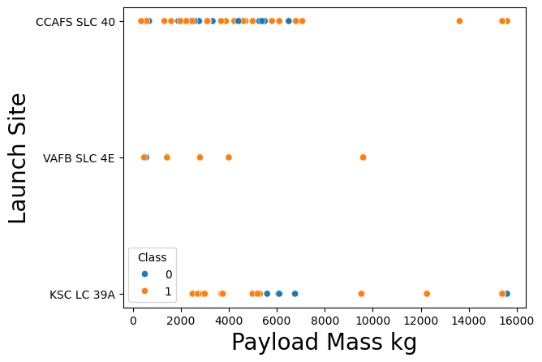
Payload vs. Launch Site

Slide 20
Success Rate vs. Orbit Type
Show a bar chart for the success rate of each orbit type
Show the screenshot of the scatter plot with explanations

Slide 21
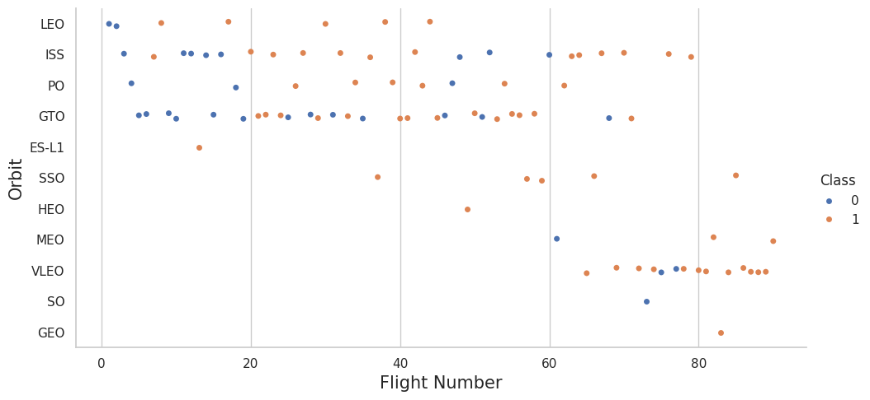
Flight Number vs. Orbit Type

Slide 22
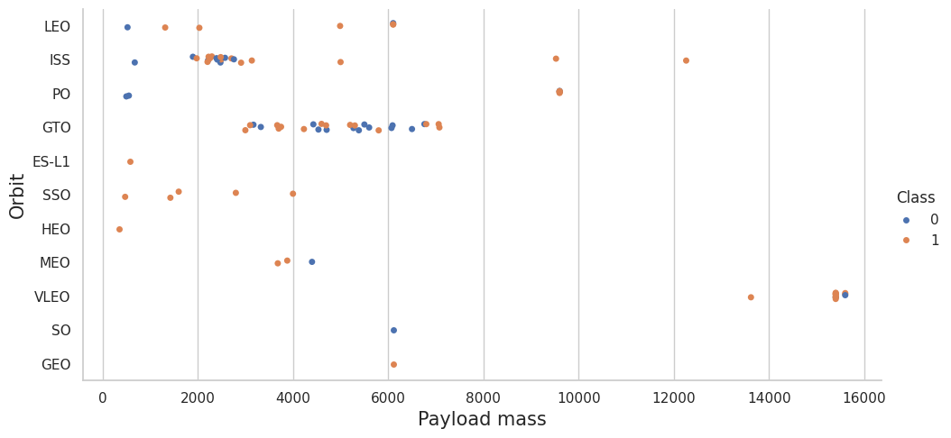
Payload vs. Orbit Type
There are strong correlation between ISS and payload at the range around 2000, as well as between GTO and the range of 4000-8000

Slide 23
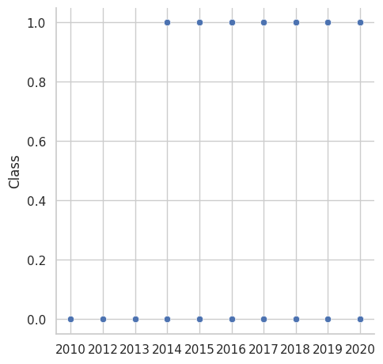
Launch Success Yearly Trend

Slide 24
All Launch Site Names
The four unique launch sites in the space mission.
I have used 'DISTINCT' statement to find the unique values in the launch site column.

Slide 25
Launch Site Names Begin with 'CCA'
5 records where launch sites begin with the string 'CCA'.The query uses WHERE, LIKE and LIMIT.e

Slide 26
Total Payload Mass
Total payload mass carried by boosters launched by NASA using SUM function and WHERE clause.

Slide 27
Average Payload Mass by F9 v1.1
The average payload mass carried by booster version F9 v1.1 using AVG function.

Slide 28
First Successful Ground Landing Date
The data when the first successful landing outcome in ground pad was achieved using MIN function.

Slide 29
Successful Drone Ship Landing with Payload between 4000 and 6000
The names of boosters which have success in drone ship and have payload mass greater than 4000 but less than 6000 combining WHERE clause with AND operator.

Slide 30
Total Number of Successful and Failure Mission Outcomes
The total number of successful and failure mission outcomes.The queryuses a combination of COUNT function with Group by statement.

Slide 31
Boosters Carried Maximum Payload
The names of the booster_version which have carried the maximum payload mass.

Slide 32
2015 Launch Records
The failed landing_outcomes in drone ship, their booster versions, and launch site names for in year 2015

Slide 33
Rank Landing Outcomes Between 2010-06-04 and 2017-03-20
The count of landing outcomes (such as Failure (drone ship) or Success (ground pad)) between the date 2010-06-04 and 2017-03-20, in descending order. The query uses COUNT, WHERE, BETWEEN and GROUP BY

Slide 34

Section 3

Slide 35
<Folium Map Screenshot 1>
Replace <Folium map screenshot 1> title with an appropriate title
Explore the generated folium map and make a proper screenshot to include all launch sites’ location markers on a global map
Explain the important elements and findings on the screenshot

Slide 36
<Folium Map Screenshot 2>
Replace <Folium map screenshot 2> title with an appropriate title
Explore the folium map and make a proper screenshot to show the color-labeled launch outcomes on the map
Explain the important elements and findings on the screenshot

Slide 37
<Folium Map Screenshot 3>
Replace <Folium map screenshot 3> title with an appropriate title
Explore the generated folium map and show the screenshot of a selected launch site to its proximities such as railway, highway, coastline, with distance calculated and displayed
Explain the important elements and findings on the screenshot

Slide 38

Section 4

Slide 39
<Dashboard Screenshot 1>
Replace <Dashboard screenshot 1> title with an appropriate title
Show the screenshot of launch success count for all sites, in a piechart
Explain the important elements and findings on the screenshot

Slide 40
<Dashboard Screenshot 2>
Replace <Dashboard screenshot 2> title with an appropriate title
Show the screenshot of the piechart for the launch site with highest launch success ratio
Explain the important elements and findings on the screenshot

Slide 41
<Dashboard Screenshot 3>
Replace <Dashboard screenshot 3> title with an appropriate title
Show screenshots of Payload vs. Launch Outcome scatter plot for all sites, with different payload selected in the range slider
Explain the important elements and findings on the screenshot, such as which payload range or booster version have the largest success rate, etc.

Slide 42

Section 5

Slide 43
Confusion Matrix
Show the confusion matrix of the best performing model with an explanation

Slide 44
Conclusions
As all the algorithms are giving the same accuracy, they allperform practically the same.
By using our machine learning model, we can predict if the first stage of our competitor will land and determine the cost of a launch.

Slide 45
Appendix
For notebooks, datasets and scripts, follow the Github repository link

Slide 46


